Slide 1

Spartan Ride SJSU Shuttle Services: An App for Everyone

Slide 2
The Motivation Behind the App
At SJSU, commuting is a daily struggle for both students and faculty. Whether it's relying on a combination of buses, trains, and long walks, or facing delays and crowded public transit—getting to and from campus often becomes a time-consuming and stressful routine.
We recognized this common pain point: valuable time lost in transit, day after day.
That’s why we created Spartan Ride — a dedicated SJSU shuttle service app built specifically for the campus community.
Spartan Ride is more than just a ride-sharing tool — it’s a smart, safe, and time-saving mobility solution designed to improve how we commute.

Slide 3
About Project
Operational Database:
Analytical Database:
Powers the core functionality of the Spartan Ride app.
Empowers administrators and university officials with actionable insights.
Manages ride bookings, shuttle routes, user registrations, and payments
Tracks shuttle usage patterns, peak travel hours, and common pickup/drop-off zones.
Enables students and faculty to book rides, submit feedback, and view schedules seamlessly.
Analyzes trends in ride demand, feedback ratings, and driver performance over time.
Supports drivers and admins in processing ride requests and managing feedback efficiently.
Facilitates data-driven improvements in route planning, scheduling, and resource allocation to optimize the shuttle service.

Slide 4
APPLICATION DESIGN
Tools Used:
Data Sources:
Python, PyCharm, PyQT, MySQL, GitHub, ERDPlus
•Mockaroo: https://www.mockaroo.com/
Python Libraries and SQL queries:
Numpy, Pandas, PyQT, Matplotlib, Seaborn, Smtp library for email and mysql-python connector

Slide 5

Student & Faculty Portal: Your Ride, Your Way
Profile Management
Ride Booking
Ride History & Wallet
Update personal info quickly and securely.
Book rides easily with real-time tracking and scheduling.
Track past rides and manage your balance effortlessly.

Slide 6




Admin Portal: Oversight and Management
User Management
Analytics
View and manage drivers, students, and faculty accounts.
System-wide performance tracking with detailed ride data.

Slide 7
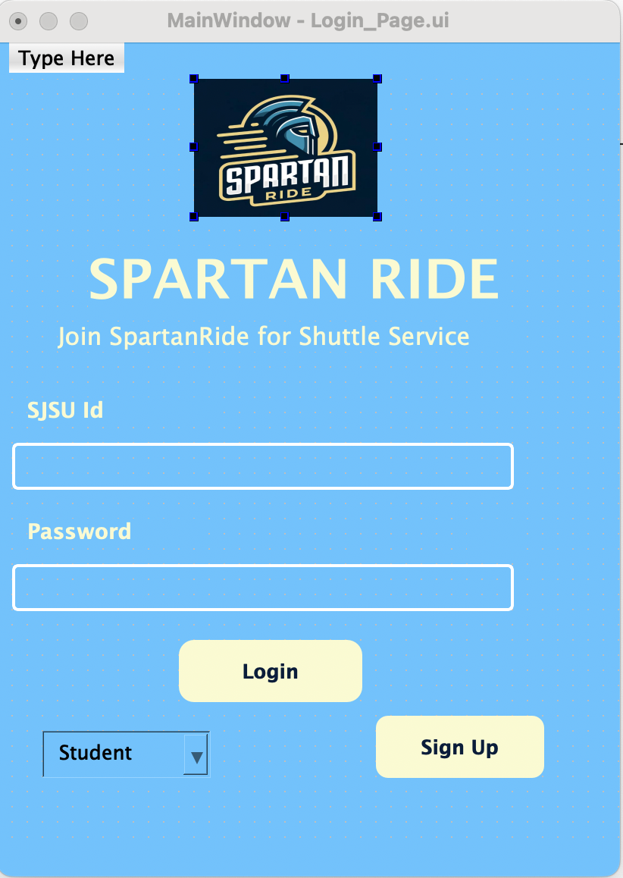
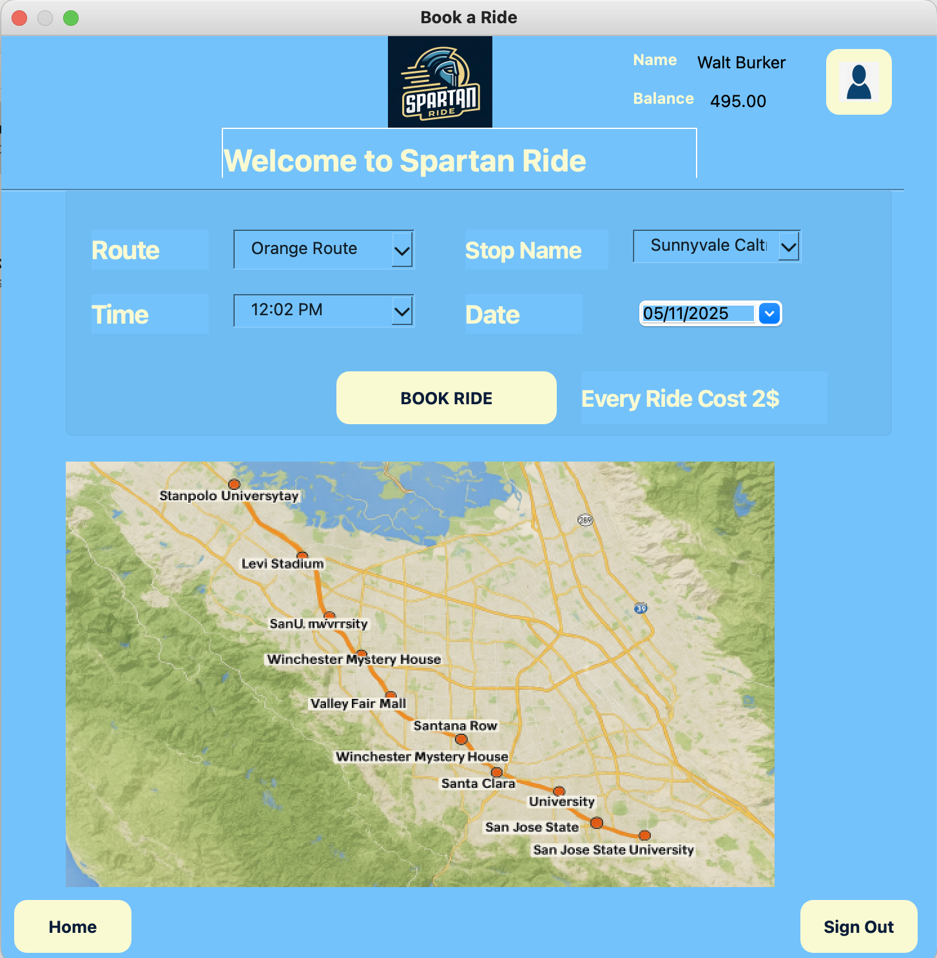
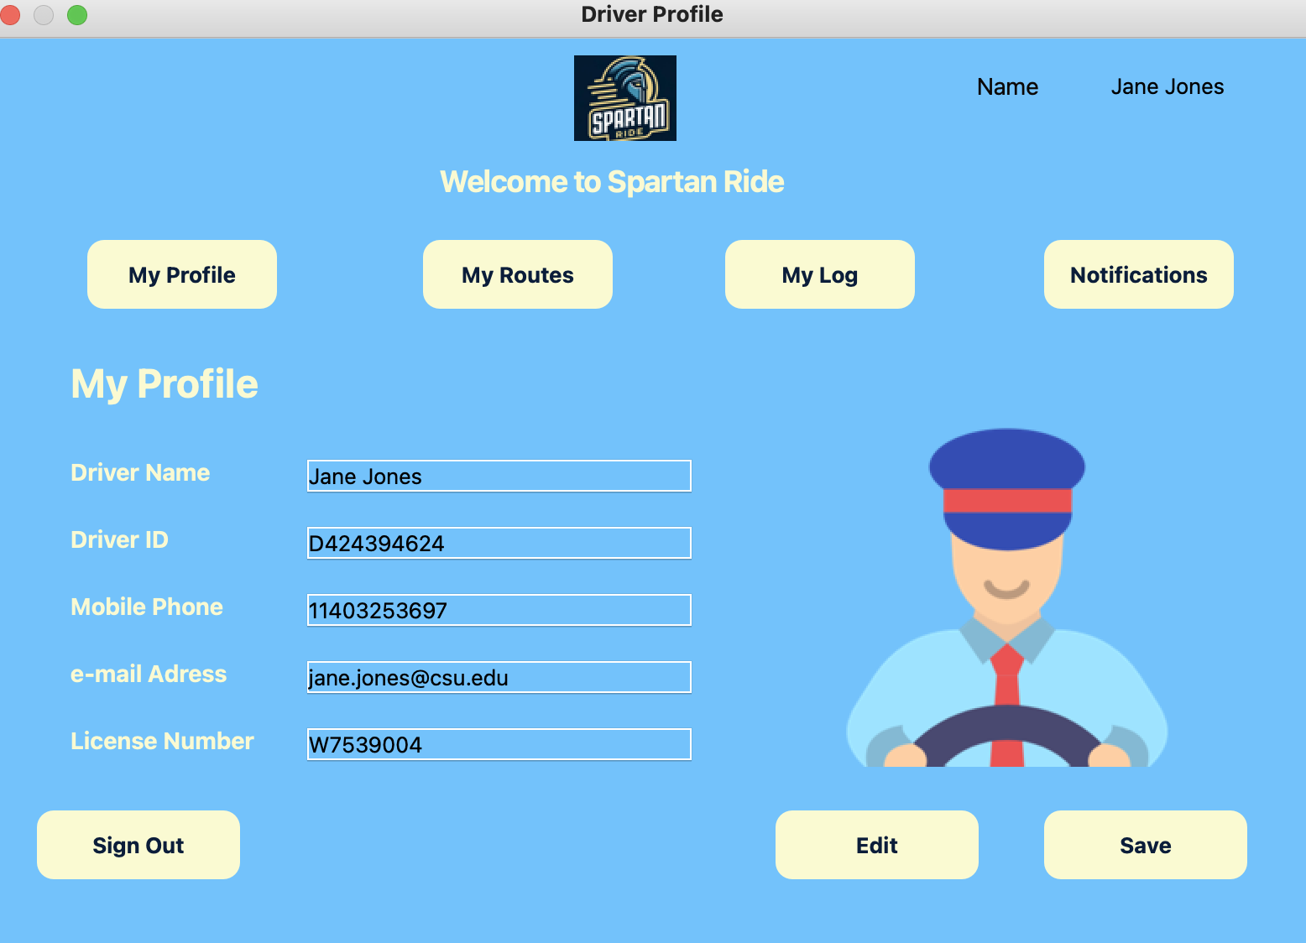
Key Features in Action: Screenshots & Demos
Login Screens
Ride Booking
Driver & Admin Views
Distinct entry points for all user types.
Interactive map to schedule and track rides easily.
Route planning for drivers and user control for admins.

Slide 8
ER Diagram

Slide 9
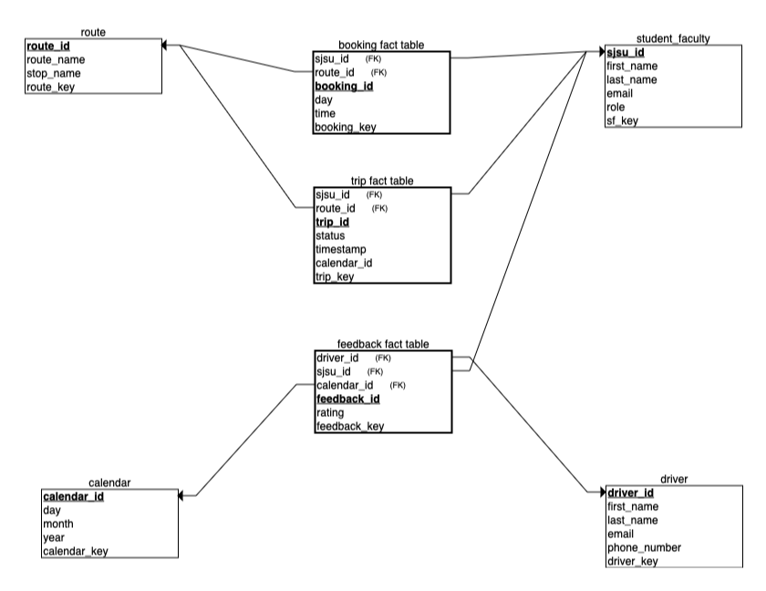
ANALYTICAL DATABASE STAR SCHEMA

Slide 10

Transforming SJSU Transportation
User-Centered Design
App focused on improving daily transit for all campus members.
Efficiency & Sustainability
Driving greener, faster, and more reliable shuttle services.

Slide 11
"Impact & Future Enhancements"
Impacts
Future Enhancements
Reduced commute stress for SJSU students and faculty by offering a direct shuttle solution.
Real-time GPS tracking of shuttles directly in the app.
Push notifications for ride arrival, delays, or cancellations.
Saved time daily for users previously relying on multi-step public transport (bus → train → walking).
Automated route optimization using AI to reduce wait times.
Increased safety with a controlled, campus-only user base and driver verification.
Expansion to nearby campuses or partner universities.
Promoted a sense of community through peer-based ride-sharing among Spartans.
Laid the groundwork for a smart, sustainable campus mobility system.

Slide 12
Thank You!!!!

